Slide 1
Vocabulary Cards

Slide 2
Start by folding a note card into four quadrants
The next two slides describes what goes on the note card and where.

Slide 3
Vocab Card (front)
word Definition
Picture related words (3 min)
or useful facts

Slide 4
Vocab Card (back)
Generate a sentence with the vocabulary word to show you understand its meaning.
i.e. Analogy and/or example
NOT THE DEFINITION
Name and Personal LOGO

Slide 5
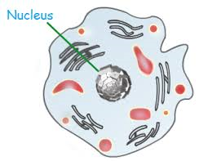
Example Card (front)
Nucleus | Definition: in eukaryotic cells—a membrane bound organelle that contains cells DNA and that has a role in processes such as growth, metabolism, and reproduction
 | Organelle, control center, DNA, holds genetic material, involved in making proteins

Slide 6
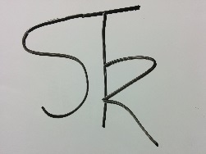
Example Card (back)
This is the control center of the cell; guiding all cellular activities to maintain homeostasis and life processes
Name, Personal Logo or symbol (not sure use your initials) Example: Scott T Resch

Slide 7
Vocabulary words
Using the format from the previous slides, make your own vocabulary cards for this unit.
Yes it is a grade—this is going to replace some of the homework that you were getting.
start with the vocabulary on pages: 67 and 87

